Slide 1
Machine learning
For Developers

Slide 2

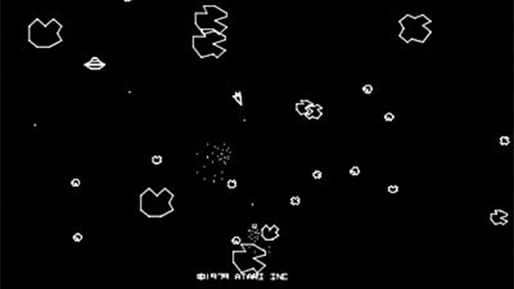
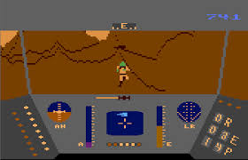

Ready player one
Bresenham's line algorithm
DirectX

Slide 3

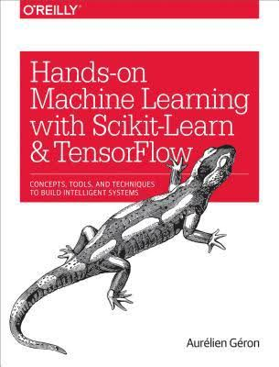
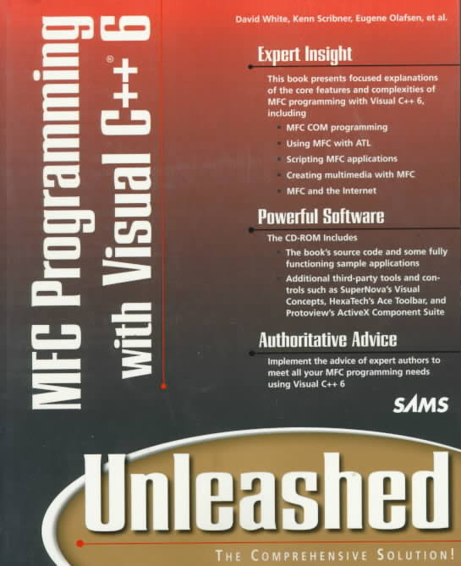
Authoritative sources

Slide 4
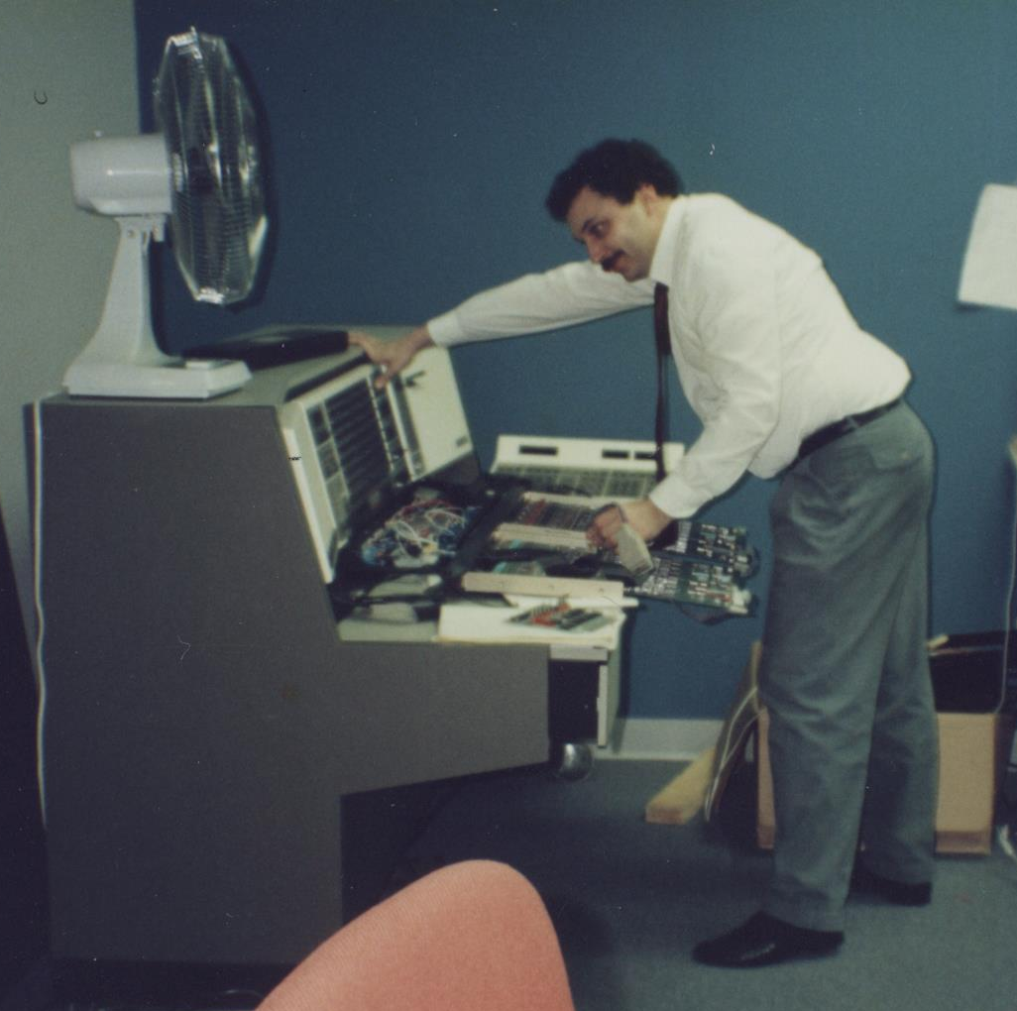
The beginning...
What
"The ability for the machine to learn without specific programming." -- A. Samuel '59 (IBM)
Where
OCR
Diagnostics – a 'self-learning' alternative to rule-based Expert Systems
Why
Solve complex problems where the solutions are not obvious
Assist carbon-based lifeforms in understanding a dataset
Replace systems that require babysitting
Exist as systems that can adapt to change over time

Slide 5
Popular Machine Learning Toolkits
Tensorflow – Google (open source)
Scikit-Learn (mostly Python library) - Google (open source)
CNTK – Microsoft Cognitive Toolkit (open source)
Amazon AI

Slide 6
Software that adapts
Human Involvement
Traditional Code
Write Program
Write Rules
Deploy
Machine Learning#1
Write Program
Train Model
Deploy
Machine Learning#2
Write Program
Train Model
Deploy
Reinforced Learning
Can be Automated

Slide 7
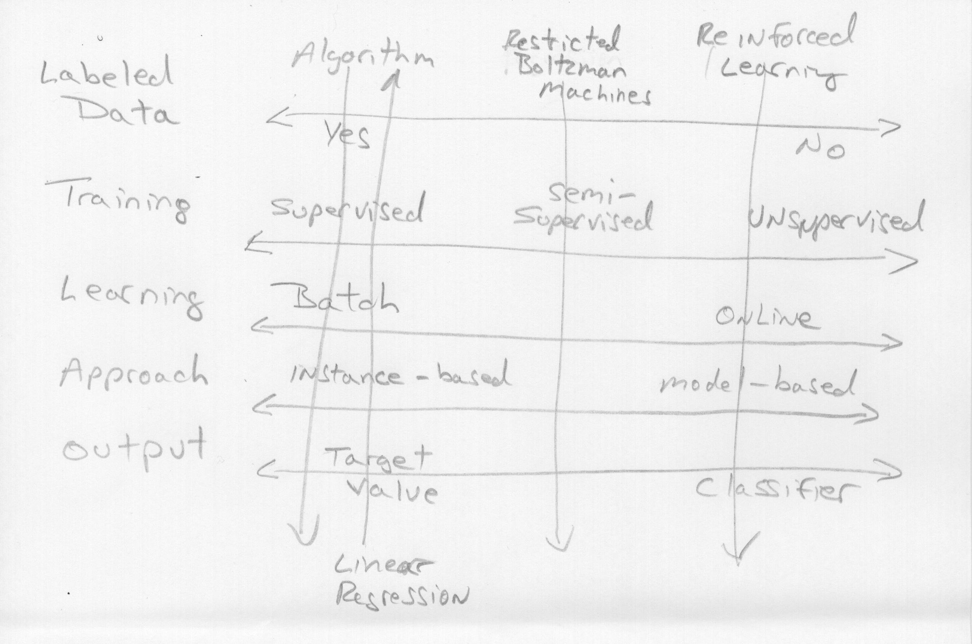
Enter the matrix

Slide 8
ML First Terms
Feature: An input to the system
Terms in many cases which are substituted for feature
Attribute = Type of Data (Weight, Height, Age)
Predictor = Attribute + Value (I.e. 35 years old, 128,000 miles)
Label: An expected output (associated with the feature(s))

Slide 9
Supervised Learning
Utilizes one or more training sets (features) which include the desired outcomes (labels).
Useful for:
Obtaining a value (prediction)
Identifying a class

Slide 10
Semisupervised learning
Can accept partially labeled data.
By providing the identification of one or more data instances (labels) the algorithm strives to provide identification across the entire data set.

Slide 11
Unsupervised learning
Utilizes unlabeled training data sets.
The data set consists of features (inputs) without the anticipated answers (labels).
Commonly used to visualize large complex data sets. There are algorithms that can plot the data in 2D and 3D to help (humans) identify patterns.

Slide 12
Reinforced learning
A process by which the machine learning system strives to maximize reward.
Reinforced learning is very different from systems typically used by the other learning strategies.
Examples:
Winning at Go (AlphaGo)
Robot balancing (Segway, inverted pendulum)
Atari video game mastery

Slide 13
Batch (offline) Learning
Pros:
Offer 'laboratory-like' control over the training
Learning can be done on high powered machines
Cons:
To update the existing system must be stopped and restarted with new 'knowledge'
Resourcing may be an issue regarding training environments – processor, disk, network

Slide 14
Online learning
Pros:
Facilitates out-of-core learning. Works on datasets that are too large to load at once.
Cons:
Bad data will degrade system outputs (E.g. Faulty sensors)

Slide 15
Instance-Based Learning
Utilizes a measure-of-similarity to compare learned attributes against new instances
A family of learning algorithms that, instead of performing explicit generalization, compares new problem instances with instances seen in training.

Slide 16
Model-Based Learning
A model is built on training data from which predictions are made.
The developer needs to select the model
Linear (Line)
Higher degree polynomial (Curve)

Slide 17
Data Challenges
Lack of training data – such data is prone to sampling noise, which is just a result of the random sample of the training data presented to the system.
Poor data quality – missing or errant data, including outliers
Non-representative data – including sampling bias
Determining features that produce results- feature engineering
Underfit data – features (or model) is too simple to provide valid results
Overfit data – model is to complex for the amount of data, thus tends to make broad generalizations

Slide 18
Data or Algorithm
A number of influential papers show that is many cases the difference between good and bad machine learning outcomes depends more on the quantity of the data (scrubbed for quality) rather than the selected algorithm.
- Banco and Brill, 2001
- Norvig, 2009

Slide 19
Dataset division
Dataset
Training
test
Training
Validation

Slide 20
Precious resource
The best machine learning outcomes can be achieved by carefully managing your dataset.
Dataset

Slide 21
Dataset division
A typical first step is in dividing your dataset 70/30 between training and test.
Training
test

Slide 22
Dataset division
Dividing your training data further into a number of validation sets can help you achieve better model outcomes.
Each of the smaller validation data sets is called a fold.
A technique known as K-fold cross-validation can be used when tuning your model.
Training
Validation

Slide 23
The starting line

Slide 24
Consider this data
Training Data
Using this data as a starting point, we would like to make predictions about data which we have not seen.

Slide 25
Consider this data
Predictions of unknown or future data can be made if we can generalize our understanding of the data we have access to.
This generalized understanding of the data is performed by a model.
A linear function is a relatively simple equation describing a 'line'… if appropriate, it may be a model of the data.

Slide 26
Drawing a LINE THROUGH DATA
Training Data
This is a linear model.
(Congratulations and welcome to your first machine learning model.)

Slide 27
Let's introduce some validation data
Training Data
Validation Data
(Some of the available data was set aside for use in validating the model.)

Slide 28
consider this model validated
Training Data
Validation Data
(The validation data seems to fall in line nicely with the training data.)

Slide 29
Using the Model
Given an input, the model can predict a meaningful output.

Slide 30
how does the model perform with production Data?
Training Data
Validation Data
Production Data

Slide 31
Linear Model success
Training Data
Validation Data
Production Data
Input values provided to the model when it is fielded in production, result in outputs which are consistent with other data in the model.

Slide 32
Linear Model possibilities
Training Data
Validation Data
Production Data
There are an infinite number of lines that can be drawn across the dataset... how did we arrive at the most representative one?

Slide 33
Linear Model Iteration
Training Data
Validation Data
Production Data
The software adjusted the parameters of the line until the 'best fit' was achieved.

Slide 34
modus operandi
Iteration is a substantial part of the machine learning process.
For the developer:
Assessment of the quality of the data
Consideration of the features fed into the model
Analysis of the outcome(s) the model produces
For the machine:
Refinement of the model parameters
Train on various data sets

Slide 35
throwing a curve
More sophisticated functions can be used to model increasingly complicated data sets.t

Slide 36
Predictive Analytics
Use current and historical data to make predictions about unknown data.
Application:
Shopping behavior / Cross sell
Fraud detection
Sales process (CRM)

Slide 37
Classifier (Binary Classifier)
The model distinguishes between two classes.

Slide 38
Classification
Identify which set of categories an observation (data element) belongs.
Application:
Handwriting and speech recognition
Computer vision
Pattern recognition

Slide 39
Data Conditioning Terms
Overfit Data – model does not generalize well
It may perform well on training data, but outliers or other differences in validation sets cause unexpected results.
Underfit Data – model is too simple to represent the data
Scaling (Normalization) - standardizes the range of data features (typically between –1 and 1)
Learning routines will typically converge to 'answer' when working with scaled data
One-hot Encode – convert categorical data

Slide 40
Data grooming techniques
Dimensionality Reduction – technique to simplify the data without losing fidelity.
Feature Extraction – removal or combination of correlated features
Anomaly Detection and Removal - outlier

Slide 41
Reinforced Learning first Terms
Reward – positive reinforcement for action taken
Penalty – negative reinforcement for action taken, or negative reward.
Policy –the strategy used to obtain a goal
Agent – a learning system

Slide 42
Data Visualization terms
Correlation – variables that tend to move in the same direction
Tail Heavy – data which tends to one axis
Logarithmic techniques can be used to
Outliers – Obvious spurious data

Slide 43
Algorithm terms
Hyperparameter - configuration that is external to the model and whose value cannot be estimated from data.
copy values used on other problems
search for the best value by trial and error

Slide 44
Training analysis Terms
Fitness (or Utility) function – measures how well a model is performing.
Cost function – measures how poorly a model is performing.

Slide 45
Test Terms
Out-of-sample or generalization error
Indicates how well the model performs
(K-fold) Cross-validation
The model is trained against different subsets
RMSE - Root Mean Square Error

Slide 46
Solution development steps
Frame the problem
Select performance measures
Define the data types
Acquire the data
Divide the data
Visual the data - look for outliers and correlations
Transform the data

